Slide 1

DEC 2025
INTRODUCTION TO KNOWLEDGE ENGINEERING
CS RESEARCH KNOWLEDGE GRAPH
JULIA GRACE M
MOSES RAJ M
SUBRITI
SUMANTH

Slide 2
Introduction
  Research in CS generates thousands of papers, patents, and grants every year.
  All of these are stored in different datasets: DBLP, NSF, USPTO.
  Challenge: lack of unified structure for analyzing CS research evolution.
  Goal: Create a semantic knowledge graph connecting funding, publications, innovation in the field of CS

Slide 3
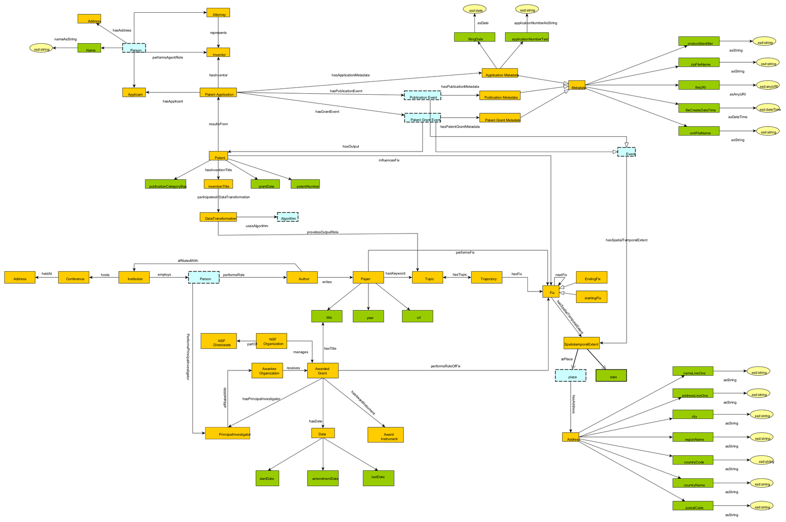
Schema Diagram

Slide 4
Classes and Relations
  Core classes:
Paper, Patent, Grant, Author, Institution, Topic, Trajectory, Fix, SpatiotemporalExtent
  Key relations:
writes, performs, manages, hasTopic, hasFix, influences, hasGrantEvent, partOfTrajectory, etc.

Slide 5
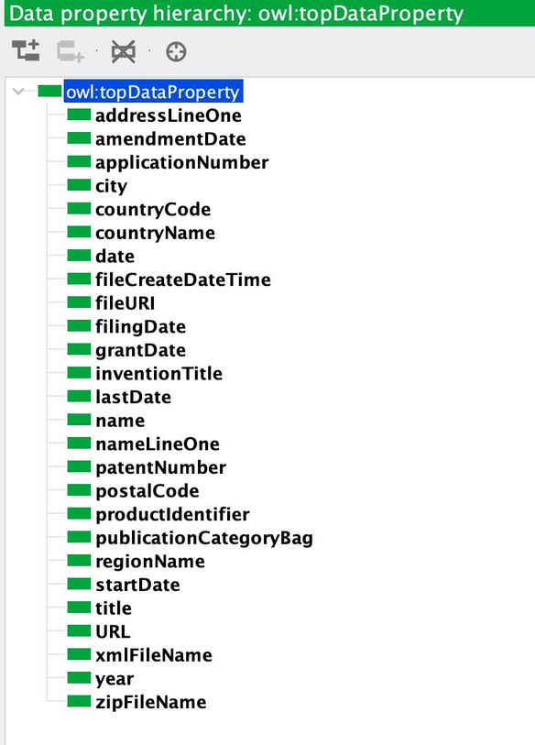
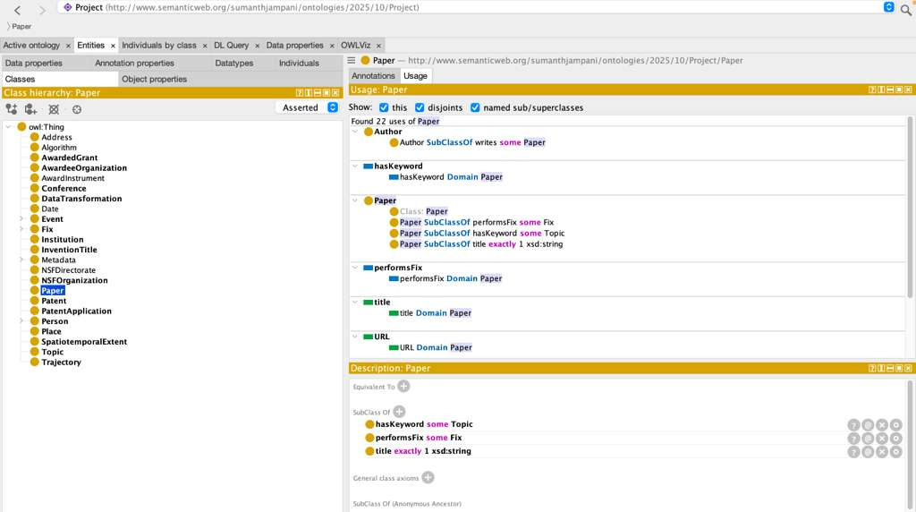
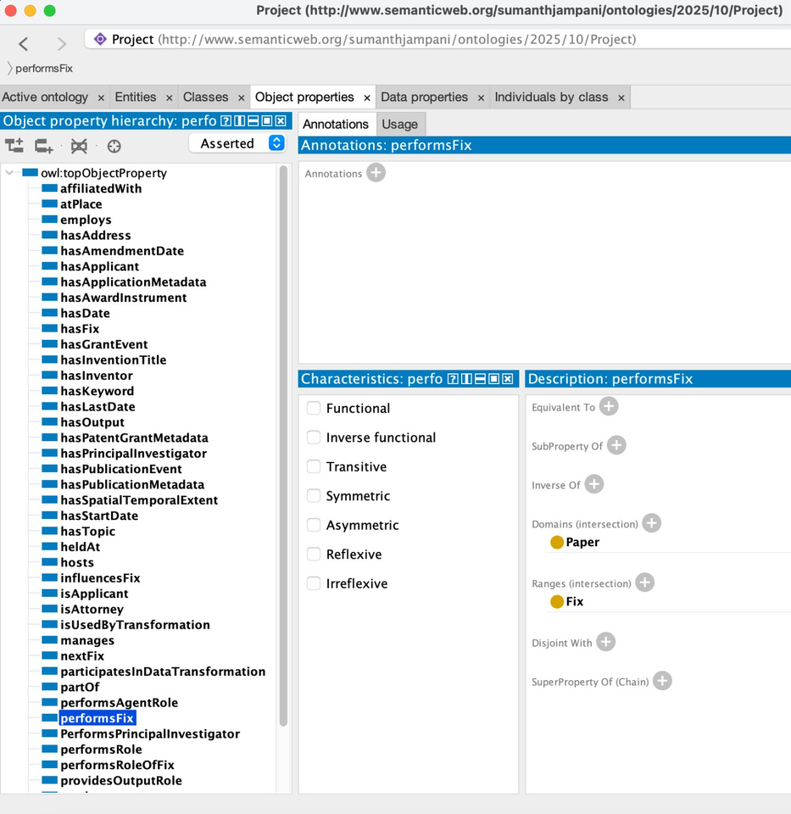
Axiomatization
Axiomatization is the process of defining the core rules and constraints of a knowledge domain so that all other facts can be logically derived.

Slide 6
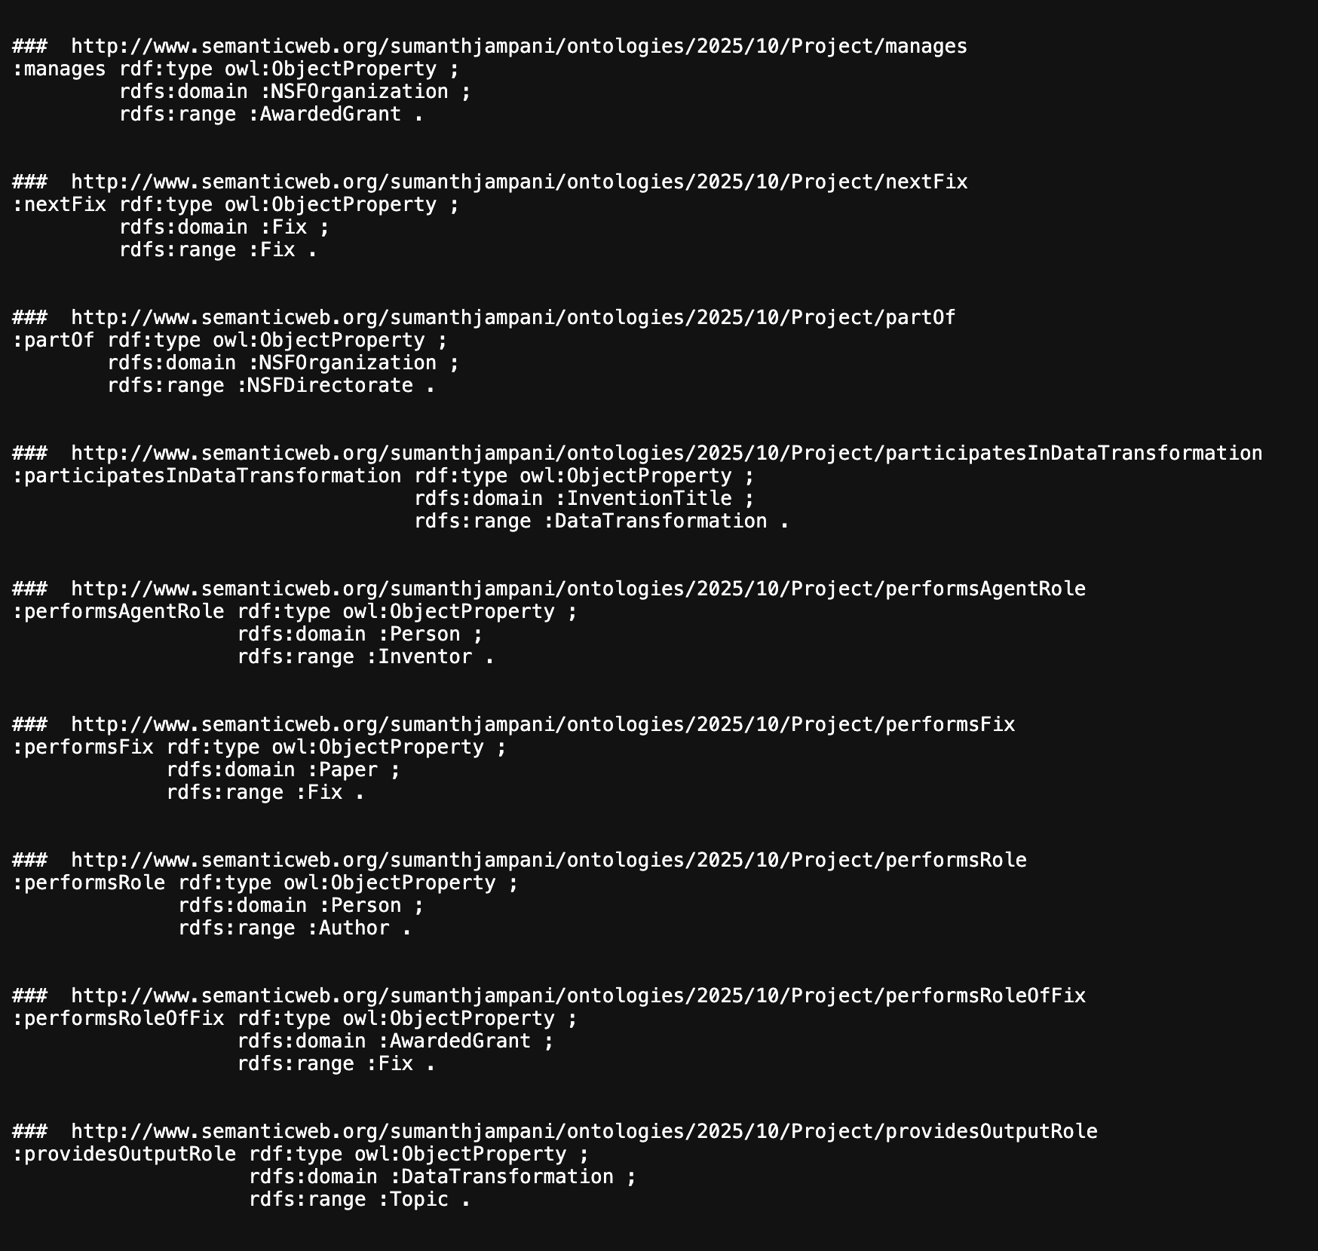
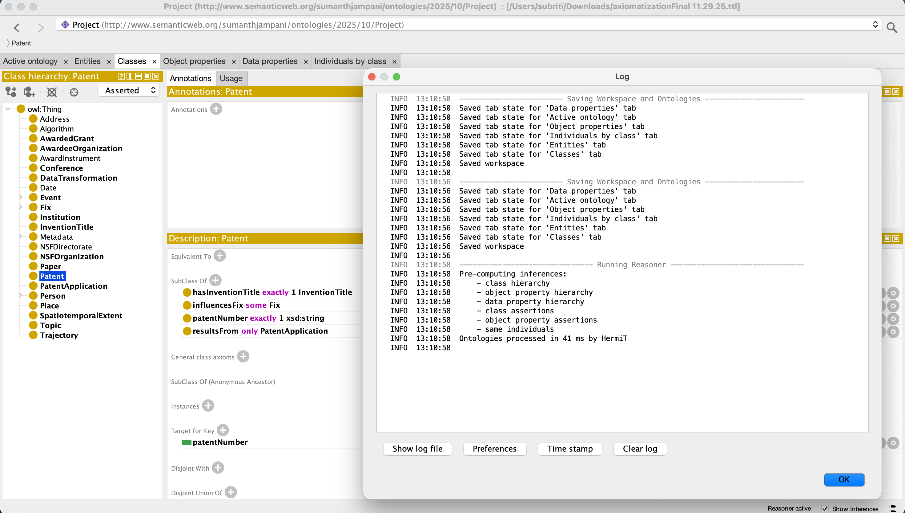
Why is Axiomatization important?
Because once these axioms are in place, the reasoner can start doing the heavy lifting.
It can infer new relationships, detect errors, and verify whether our model is logically sound—almost like having a built-in quality check for the ontology.

Slide 7
Data Transformation
Common Entities
• Authors
DBLP → authors of papers
Patents → inventors
NSF → Principal Investigators (PI/Co-PI)
• Research Topics / Keywords
DBLP → extracted from paper titles/keywords
Patents → extracted from abstracts/claims
NSF → topics from award abstracts/keywords
• Temporal Information
DBLP → publication year
NSF → award year & duration
Patents → filing date, grant date

Slide 8
Data Transformation
Data Cleaning
  Convert all dates to a single format
  Standardize author/institution names
  Normalize topics/keywords
Topic Extraction
  TF-IDF keyword extraction
  Contextual embeddings (BERT)
  Topic modeling
Clustering to Find Topic Groups
  Group similar papers, patents, and NSF awards together
  Creates unified topic clusters

Slide 9
Competency Questions
1Q. Which institutions have received the most NSF grants related to AI research?
Ans) Grants are identified through the hasKeyword relation connecting a Paper to a Topic.
Each Grant is then linked to an Institution via the awardedTo relation.
Counting the number of grants for a particular Topic gives the answer of how much funding is going into one Research Topic.

Slide 10
2Q. How has CS topics evolved over time?
Ans) Each Topic has a Trajectory, made up of time-ordered Fixes, and each Fix corresponds to a Paper with a publication date.
By aggregating these fixes along the trajectory, the ontology provides a timeline showing how a CS topic has evolved over time.

Slide 11
3Q. Which NSF projects produced the highest innovation velocity?
Ans) The number of papers and patents that are being released in a particular Topic after a grant is issued is the innovation velocity
Using the awardDate of the grant and the hasDate values of resulting papers/patents, the ontology measures how quickly new outputs appear.
This allows computation of innovation velocity.

Slide 12
4Q. Which authors frequently publish in both academic venues (conferences/journals) and also file patents?
Ans) The schema links an Author to Paper and Inventors to their Patents.
Person who appear in both sets—those who have writes → Paper (Venue) and files → Patent (hasInventor) —are identified as publishing academically while also generating patents.

Slide 13
5Q. Which NSF-funded areas have produced patents most rapidly (shortest time lag)?
Ans) Each Grant is linked to one or more Topics and to resulting Patents.
By comparing the awardDate of a grant with the hasDate of patents connected to it, the ontology can compute the shortest time lag.
This shows which NSF-funded areas generate patents the fastest.

Slide 14
THANKYOU

